Slide 1
WIDS DATATHON 2020 ICU MORTALITY PREDICTION
Team Name: FOX
Prepared by:
Ang Khee Hwa Randi A0198526N
Ee Meng Hock A0163456B
Fang Wenlin A0198417R
Shen Chen A0058260J
Xiao Jinting A0198422Y
Zhou Jingyu A0198413Y

Slide 2
Agenda
INTRODUCTION
Business Objective
DATA PREPARATION
Missing values
SCORE CARD
Imputation
MODELING
Feature generation
Setup
Evaluation
CONCLUSION
EDA
Objective
Methodology
Challenges
Summary

Slide 3
Business Objective
Problems
Current Practice
Solution
Benefits
ICU Resource Allocation
Imbalance supply and demand for bed space
Limited medical resources
Defensive medicine
APACHE Standards
Scorecard system to triage patients on a needs basis
(Higher Score, risker status)
Newer versions not widely adopted due to copyrights restrictions
Open-sourced Scorecard System
Developed based on classification modelling output
Key Values
Higher compatibility and accuracy – model customization to local factors
Optimize Resource allocation – allocate ICU beds via a patient acuity scorecard
Reduce mortality rates – timely therapeutic interventions for high risk patients
Notes:
Defensive medicine: an excessive risk management strategy by clinicians to reduce litigation risk due to negligence. This is done via ordering excessive diagnostic tests and taking more excessively aggressive treatment measures (e.g. warding a patient who does not need one). This would result in an inefficient allocation of resources for the healthcare organisation and higher medical bills for patients.

Slide 4
Dataset Introduction
Binary dependent variable
183 independent variables
91k labelled rows
39k unlabeled rows
Demographics
APACHE Covariates
Patient Vitals
Labs Blood Tests
APACHE
Comorbidity
Patient info:
Age
Gender
Weight
Height
Administrative ICU info:
Admit source, type
Length of stay
Selected Vitals, Lab Tests and Conditions
Glasgow Coma Scale (GCS)
Admission Diagnosis
Blood Composition
Vitals
Other conditions
Max and Min indicators of patient conditions:
Temperature
Pulse
Blood pressure
Respiratory rate
Oxygen saturation
Diagnostic tests:
Blood composition
Chemical balance
Arterial blood gas test data
Medical history of patients:
AIDS
Diabetes
Leukemia
First 24 hours
First hour and first 24-hour records
Medical History

Slide 5
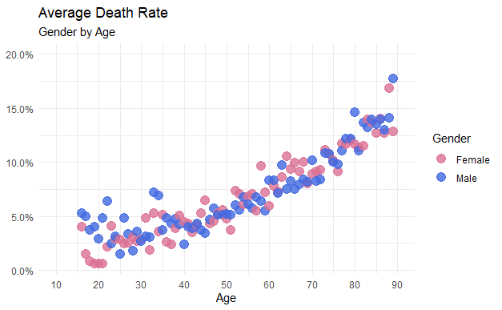
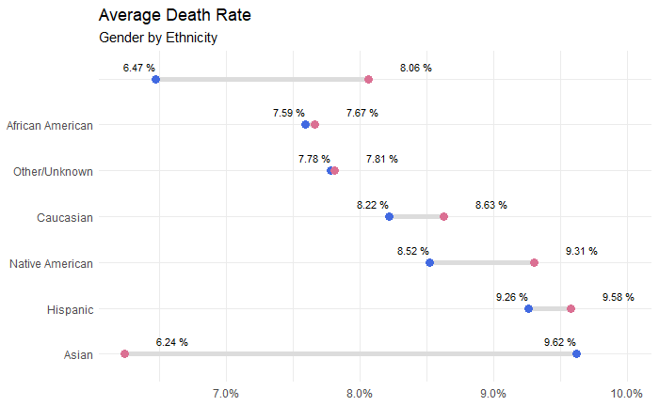
Data Exploration - Demographics
Death rate increases with age, but no visible difference between gender
Slight differences between death rates of different ethnicity, but since Caucasian dominated the dataset at 77% of total population, ethnicity is not significant in the model output
Notes:
Left:
Death rate increases with age
Right:
Ethnicity shows a clear impact of death rate on gender
Except Asian, death rate of female tend to be higher than male across all ethnic groups

Slide 6
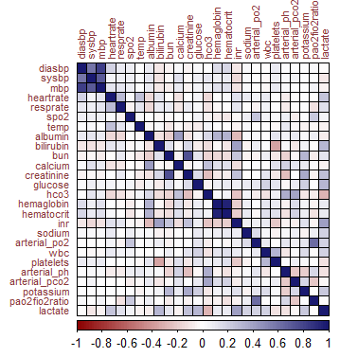

Data Exploration – Vitals and Labs Blood Tests
Weak correlation between variables, except for a two groups of variables that has the same medical interpretation
Notes:
Left:
Correlation of variables
Generally, little correlation except for variables belonging to the same category
Eg. The blood pressure group on top left corner
Hemaglobin and haematocrit
Right:
For illustration purpose, plot the normalised range of min max values
Firstly, max contains more extreme values
Secondly, individual variables has no significant impact on death rate

Slide 7
Agenda
INTRODUCTION
Business Objective
DATA PREPARATION
Missing values
SCORE CARD
Imputation
MODELING
Feature generation
Setup
Evaluation
CONCLUSION
EDA
Objective
Methodology
Challenges
Summary

Slide 8
Data Cleaning
Consider variable levels:
Imputation
Merging
Missing values
Feature engineering
APACHE covariate
Vitals
Lab Test
d1
h1
d1
h1
Min
Max
Min
Max
Min
Max
Min
Max
Imputations rules:
Base
d1
h1
APACHE covariate
Median (d1)
* Except scenario A
Order of preference
*APACHE covariates are part of the patients’ vitals ad lab-tests data collected by the hospitals, not for APACHE scoring purpose only. In fact, many of them were derived from d1 & h1 data. Hence, APACHE covariates were tagged for identification purpose to differentiate from data not used by APACHE Scoring model.

Slide 9
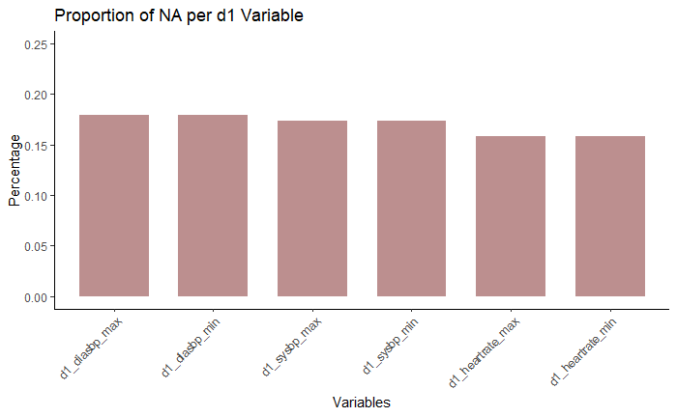
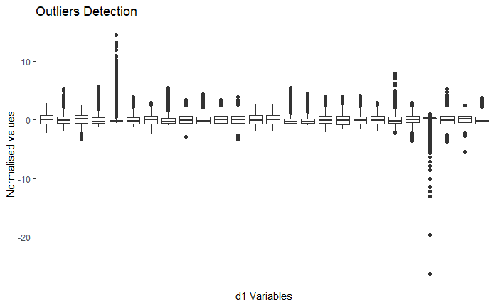
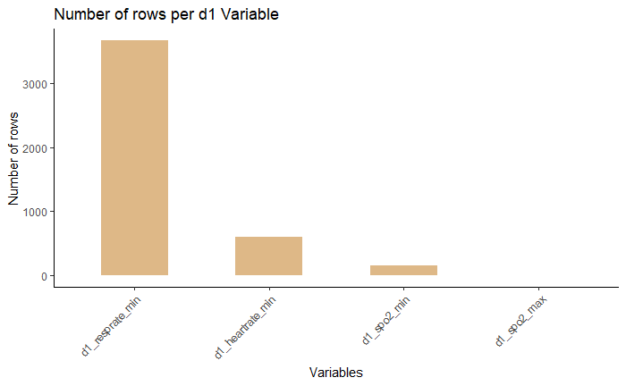
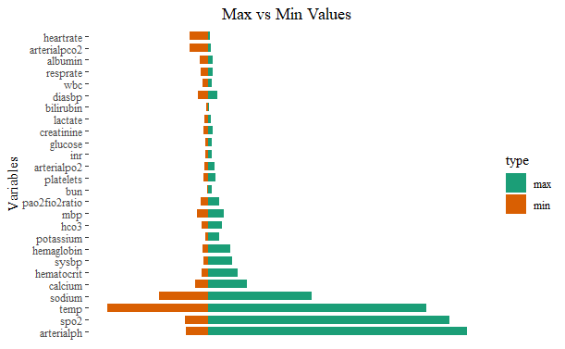
Missing values are imputed for d1 variables provided that we have h1 variables or a APACHE covariate value. Else, it will be left as NA (unknown)
A. Impute missing values
B. Impute outliers
Imputation
Merging
Missing values
Feature engineering
C. Impute variable value = 0
D. Impute when max < min

Slide 10
Data Cleaning
Merging objectives: finding the worst value
Demographics
APACHE covariate
Vitals
Lab Test
Imputation
Merging
Feature engineering
Missing values
d1
d1
Min
Max
Min
Max
Drop redundant variables
final
final
Merging Methodology:
Illustration for a single variable
Selection rules:
|X1| > |Y1| → take Min1
|X2| = |Y2| → assign bias factor based on background knowledge
X1
Y1
Goldilocks' zone
Min 2
Max 2
Value
Min 1
Max 1
Y2
X2

Slide 11
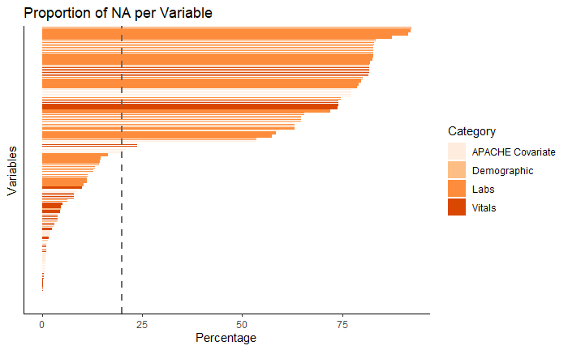
Data Cleaning
Drop variables with NA > 20%
Imputation
Missing values
Feature engineering
Merging
Drop
Most variables are redundant after the merging process.
Some variables could not be retained as >50% of data were still missing after merging.

Slide 12
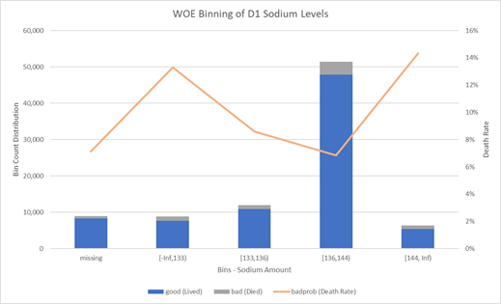
Data Cleaning
Weight of evidence (WOE) binning:
Demographics
APACHE covariate
Vitals
Lab Test
Imputation
Merging
Missing values
Feature engineering
d1
d1
Min
Max
Min
Max
Categorise
Categorise
% of patients died for variable X₁
WOE = ln
% of patients survived for variable X₁

Slide 13
Agenda
INTRODUCTION
Business Objective
DATA PREPARATION
Missing values
SCORE CARD
Imputation
MODELING
Feature generation
Setup
Evaluation
CONCLUSION
EDA
Objective
Methodology
Challenges
Summary

Slide 14
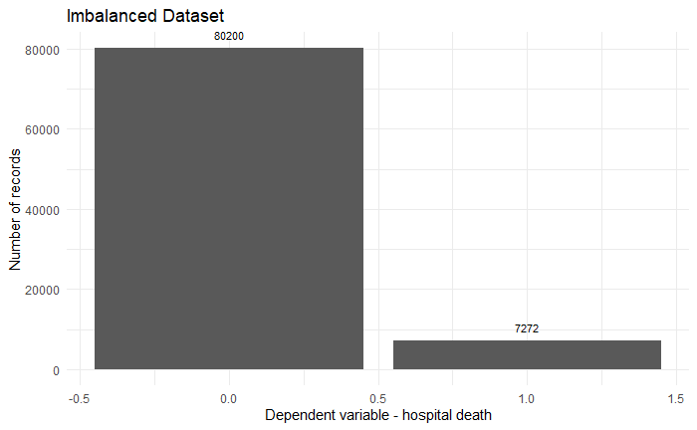
Imbalanced Dataset
Minority class of target variable is only 8%

Slide 15
Modelling Setup
Cleaned
Dataset
46 independent variables
Supervised Models
70%
61230 rows
30%
26242 rows
Train Dataset
Test Dataset
Logistic Regression
(R)
MLP Classifier
(Python)
Parameters
Depths / Layers
Over Sampling
74192 rows (32350 minority observations)
AUC: 0.88
AUC: 0.86
No. of iterations
Under Sampling
7030 rows (3515 minority observations)
Validate
Learning rate
Over & Under
40568 rows (15465 minority observations)
Decision Tree
(Python)
Gradient Boosting
(R & Python)
Weight decay
ROSE sampling
40568 rows (15649 minority observations)
Bagging
SMOTE sampling
56952 rows (23730 minority observations)
AUC: 0.74
AUC: 0.89

Slide 16
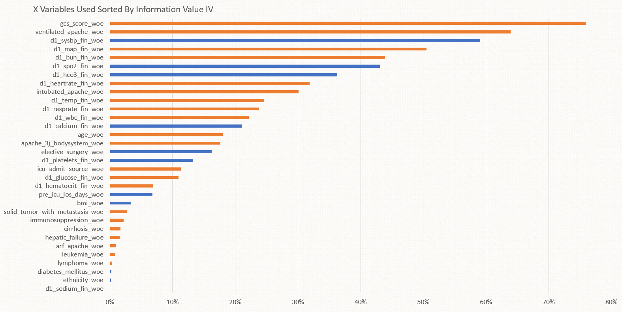
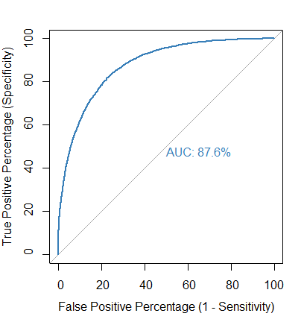
Modelling Outcome – Logistic Regression
Model Evaluation
Scorecard Variables Selection
1. Confusion Matrix
1. Predictive power
2. Independent from each other
3. Availability and ease of acquiring at hospitals
4. Account for some degree of population shift
No Resampling
Test |  | Predicted
 |  | 1 | 0
Actual | 1 | 4015 | 1053
 | 0 | 11076 | 45201
Accuracy |  | 80.2%
Sensitivity |  | 79.2%
Specificity |  | 80.3%
No Resampling
Test |  | Predicted
 |  | 1 | 0
Actual | 1 | 1728 | 476
 | 0 | 4654 | 19269
Accuracy |  | 80.3%
Sensitivity |  | 78.4%
Specificity |  | 80.5%
2. AUC curve
3. Summary
model is robust with moderately high accuracy
consistent AUC through various cross validations (90%)
accuracy, sensitivity and specificity are well balanced with little bias though different threshold values may be applied
K-Fold Cross Validation (K=10)
Mean AUC (Train): 88.0%
Mean AUC (Test): 87.9%
APACHE Covariables
Notes:
Oversampled data used. For benchmarking only.

Slide 17
Agenda
INTRODUCTION
Business Objective
DATA PREPARATION
Missing values
SCORE CARD
Imputation
MODELING
Feature generation
Setup
Evaluation
CONCLUSION
EDA
Objective
Methodology
Challenges
Summary

Slide 18
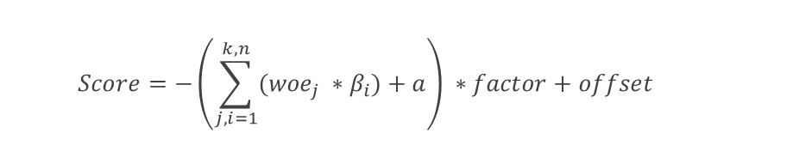
Introduction to Scorecard
Background
Modified from a credit scoring framework
Benefits:
Ease of implementation
Ease of interpretation
Parameters | Value | Description
Actual Range | -80 to 1115 | Lower score → higher odds of dying
PDO (Points to double odds) | 50 | How many points does the score change given an increase in odds
Target Odds (Bads) | 1 / score | Example: At score = 1000, Target Odds = 1/1000
General Formula
$$Score=−\left(\sum_{j, i=1}^{k, n}{({woe}_{j} ∗β_{i})}+a\right) ∗factor+offset$$
Implementation
Factor = pdo / ln(2)
Offset = Score – (factor * ln(odds))
Score = Offset + Factor * ln(odds)
Score + pdo = Offset + Factor * ln(2 * odds)
To be used as a decision making support tool
Clinicians will still be the ultimate arbiter
WOE = weight of evidence for each variable level
Β = regression coefficient for each variable
a = intercept term from logistic regression
n = number of variables in model
k = number of bins of each variable

Slide 19
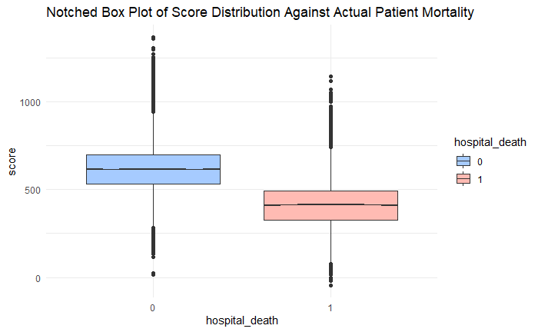
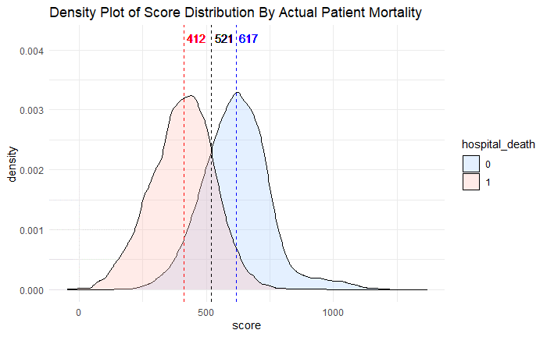
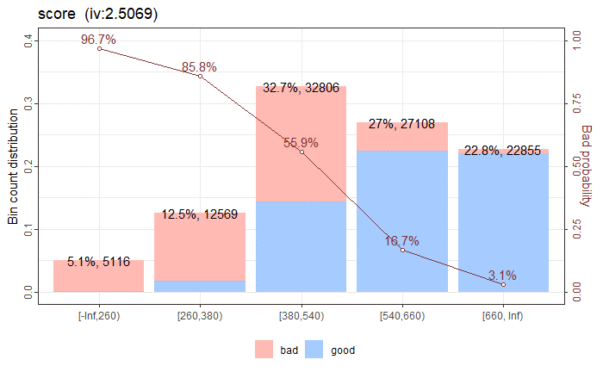
Scorecard – Proposed Triage Plan
Preliminary recommendations based on the model
Fine tuning and threshold values for final implementation would be dependent on specific business needs
Low
Score
High
Palliative Care
ICU or Palliative Care
ICU
High Dependency Ward
High Dependency Ward
General Ward
260
380
540
660
866
Notes:
* These are preliminary recommendations based on the model; consultations with business users would be required to fine tune the scorecard and threshold values for final implementation e.g. if the risk profile of the patients tend to be higher than the population used in the model, then a lower set of cut-off scores should be used for triaging and vice versa

Slide 20
Scorecard - Evaluation
Our model (Logistic Regression) is the best overall model (different threshold values applied)
.
Our Model (Balanced)
Our Model (Sensitivity)
Our Model (Specificity)
APACHE IV MP-H
APACHE IV MP-ICU
Over Sampling
Test |  | Predicted
 |  | 1 | 0
Actual | 1 | 4584 | 1137
 | 0 | 11908 | 47906
Accuracy |  | 80.0%
Sensitivity |  | 80.1%
Specificity |  | 80.1%
Over Sampling
Test |  | Predicted
 |  | 1 | 0
Actual | 1 | 4868 | 853
 | 0 | 44512 | 15302
Accuracy |  | 75.4%
Sensitivity |  | 85.1%
Specificity |  | 74.4%
Over Sampling
Test |  | Predicted
 |  | 1 | 0
Actual | 1 | 4276 | 1445
 | 0 | 9618 | 50196
Accuracy |  | 83.1%
Sensitivity |  | 74.7%
Specificity |  | 83.9%
Over Sampling
Test |  | Predicted
 |  | 1 | 0
Actual | 1 | 3894 | 1827
 | 0 | 8643 | 51171
Accuracy |  | 84.0%
Sensitivity |  | 68.1%
Specificity |  | 85.6%
Over Sampling
Test |  | Predicted
 |  | 1 | 0
Actual | 1 | 4738 | 983
 | 0 | 17417 | 42397
Accuracy |  | 71.9%
Sensitivity |  | 82.8%
Specificity |  | 70.9%
Models | No. of input variables
Our Model | 32
APACHE IV | 37++
Notes:
APACHE IV relies on the use of logistic regression as the base model
Results generated by applying our model to the observations with APACHE IV predictions
Not every observation had APACHE IV Predictions → filtering applied
The scorecard is independent of the thresholding applied to get the confusion matrices here; though it still provides a rough baseline comparison of the model's performance.
Level of filters | Sensitivity/Specificity Bias | Goal
Hospital Level (MP-H) | Biased towards specificity | Filter
ICU Level (MP-ICU) | Biased towards sensitivity | Detect at risk patients to be sent to ICU for further evaluation
Notes:
We applied our original model to the observations with APACHE IV predictions to generate these results; filtering was required as not every observation had APACHE IV Predictions. For the purposes of scorecard creation, adjusting the threshold values is not required beyond simple model evaluation, as the model is fitted into the scorecard function without the threshold values applied to decide the cutoff points. Hence, the adjustment for different threshold levels is purely for demonstration purposes.

Slide 21
Agenda
INTRODUCTION
Business Objective
DATA PREPARATION
Missing values
SCORE CARD
Imputation
MODELING
Feature generation
Setup
Evaluation
CONCLUSION
EDA
Objective
Methodology
Challenges
Summary

Slide 22
Challenges and Limitations
Data Quality
Model Limitations
Large number of missing data → limit the ability to use and re-engineer some of the variables
Data is dominated by Caucasian ethnicity → Model may not generalise well
While complex interactions can be modelled in Logistic Regression, the output cannot be easily interpreted and implemented in Scorecard.
The model may not predict well for new or rare cases of illnesses, firearms and CBRE injuries; and times when hospital resources are severely stressed (e.g. pandemic and mass casualty scenario)
Lack of Domain Knowledge
Domain knowledge is required to
understand how the X variables are used for the diagnosis of diseases and body function; and any relationship between them
determine the thresholds for the Scorecard category and the medical/business decisions and actions for each category
determine whether data from a variable can be readily collected in actual practice, since there is a need to avoid overburdening clinicians and patients with unnecessary tests which can lead to waste and missing data issues
make decisions on imputation values

Slide 23
End of Presentation

